Slide 1
Linear Blend Skinning

Slide 2
Same technique – different names
Linear blend skinning
Skeleton Subspace Deformation (SSD)
Smooth skinning (in Maya)

Slide 3
How it works?
Static character model (skeleton with joints) in neutral pose (dress pose)
Each vertex assigned a set of influences with blending weight
Rigidly transform each neutral pose vertex (by all of its influencing joints)
Blending weights are used to combine these transformed positions

Slide 4
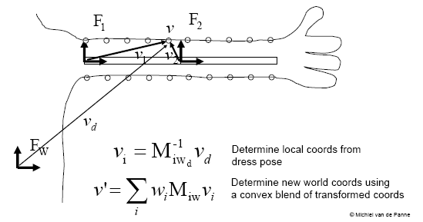

Slide 5
Problems
It cannot represent complex deformations and suffers from characteristic artifacts (candy-wrapper, collapse effect on wrists and around bending joints)
Why?
Vertices are transformed by linearly interpolated matrices (collapses near 180 degrees)

Slide 6
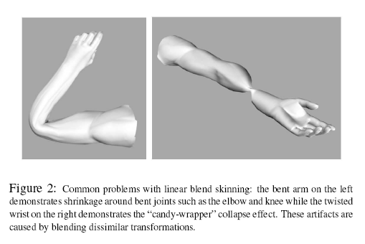

Slide 7
Solutions
Avoiding such a dissimilar blending transformations (extra transformations that properly interpolates without collapsing
I.e. twisting wrists - extra joint that interpolates the rotation angle correctly
Could be used also for muscles, wrinkles and etc.
The key: since vertices choose weighted sums of transformations, if any linear scaling of an added joint is beneficial it may be used.

